Slide 1

“JOB SEARCH APPLICATION”
Task - 1

Slide 2

Job Search Application
A Job Portal application is a place where users can search and apply for job openings. In the same application, the recruiters can post job details and seek applicants. The app is quite beneficial for both applicants and recruiters.
au910020104003 |  | CC2
au910020104044 |  | CC2
 |  | CC2
LMS Username
Name
Batch
AJITH KUMAR K
SUBHASRI M
au910020104304
GANESH KUMAR C

Slide 3

Task-1
Evaluation Metric:
Evaluate user engagement with metrics like active users, session duration, and job applications submitted.
Assess user satisfaction through ratings, reviews, and feedback on the application process.
Measure job matching effectiveness with considerations for the relevance of recommendations and successful match rates.
Analyze conversion rates, including application completion and transitions from job views to actual applications.
Monitor time to fill positions to understand the average duration for a job to be filled.
Track user retention over time to ensure sustained engagement.
Assess mobile responsiveness across different devices.
Verify data accuracy, ensuring job information and details are reliable.
Evaluate technical performance, focusing on app responsiveness and speed.
Calculate cost per hire by dividing total recruiting costs by the number of successful hires.

Slide 4
Step-Wise Description
1.Project Planning:Define goals, features, and timeline.
2.Development Foundation: Choose technologies and design a database.
3.User Experience: Implement authentication, profiles, and intuitive UI.
4.Functionality and Testing: Develop job listings, application processes, and notifications.
5.Deployment and Growth: Deploy on a reliable platform.
Project Summary
A job search app that streamlines the job hunting process, offering users a user-friendly interface to browse, filter, and apply for relevant positions. Features include personalized job recommendations, resume uploading, and real-time application tracking for a seamless job-seeking experience.

Slide 5
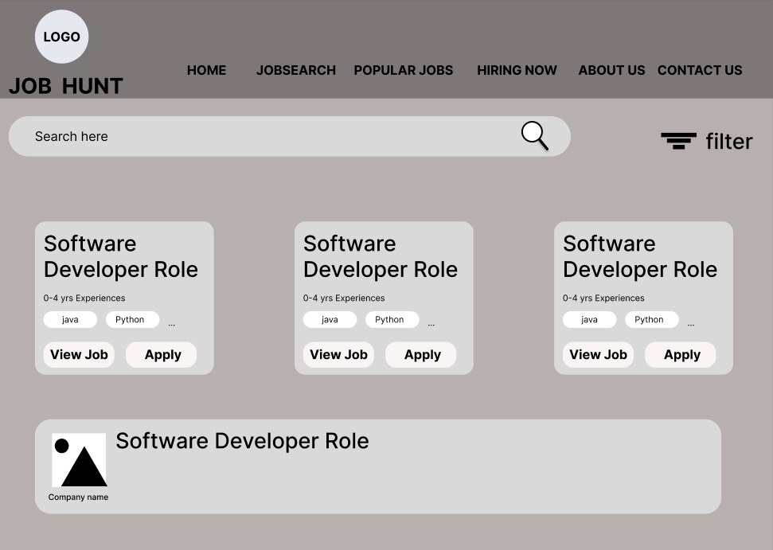
USER EXPERIENCE

Slide 6

Submission Github
https://github.com/ajithakdev/Jobsearch-App.git

Slide 7


